Slide 1
Product Success Prediction
PMI - Case study
Bernardo Fernandes

Slide 2
Summary
1. Data Preparation 1.1 Exploration . . 1.1.1 Imports, functions and load dataset . . 1.1.2 Exploring the dataset using pandas profiler . . 1.1.3 Understanding and encoding the target variable . . 1.1.4 Insights 1.2. Data Preprocessing . . 1.2.1 Data Type conversions . . 1.2.2 Group variables by data type and set the list of removals . . 1.2.3 Check cardinality . . 1.2.4 Variable populations . . 1.2.5 Detect correlated features . . 1.2.6 Summarize variable removals and drop . . 1.2.7 Train/test sampling . . 1.2.8 Undersampling the majority class . . 1.2.9 One hot encoding
2. Modeling 2.1. Regression . . 2.1.1 CatBoost Regressor . . 2.1.2 XGBoost Regressor 2.2 Classification . . 2.2.1 CatBoost Classifier . . 2.2.2 XGBoost Classifier 2.3 Model results
3. If I had more time
4. Predictions 4.1. Top predictions 4.2. Trends

Slide 3
Problem undestanding
Objective:
Predict the if a product is going to be successful
Benefits I can see/People who can use it:
Product /Marketing / Sales teams can use its output to optimize future launches

Slide 4
Plan
https://github.com/bernardoff/ML-Lab/blob/master/PMI_Test.ipynbAdd a few more bullets in the smartart
Assumptions
Explore Data
Variable Statistics
Prepare Data
Train Model
Model tuning
Interpret Results
Feature Engineering
EDA
Data pipeline
Feature importance
Predictions
Test performance

Slide 5
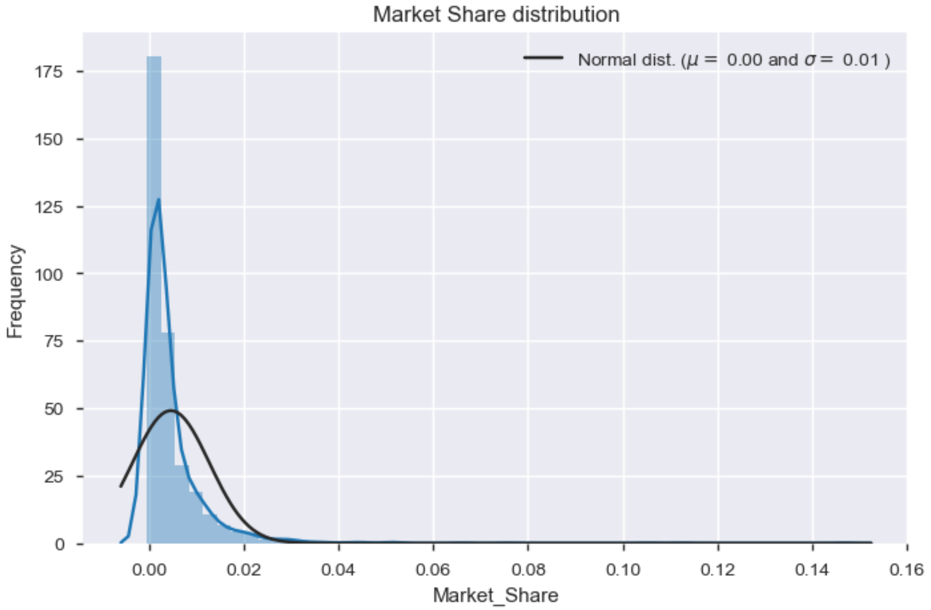
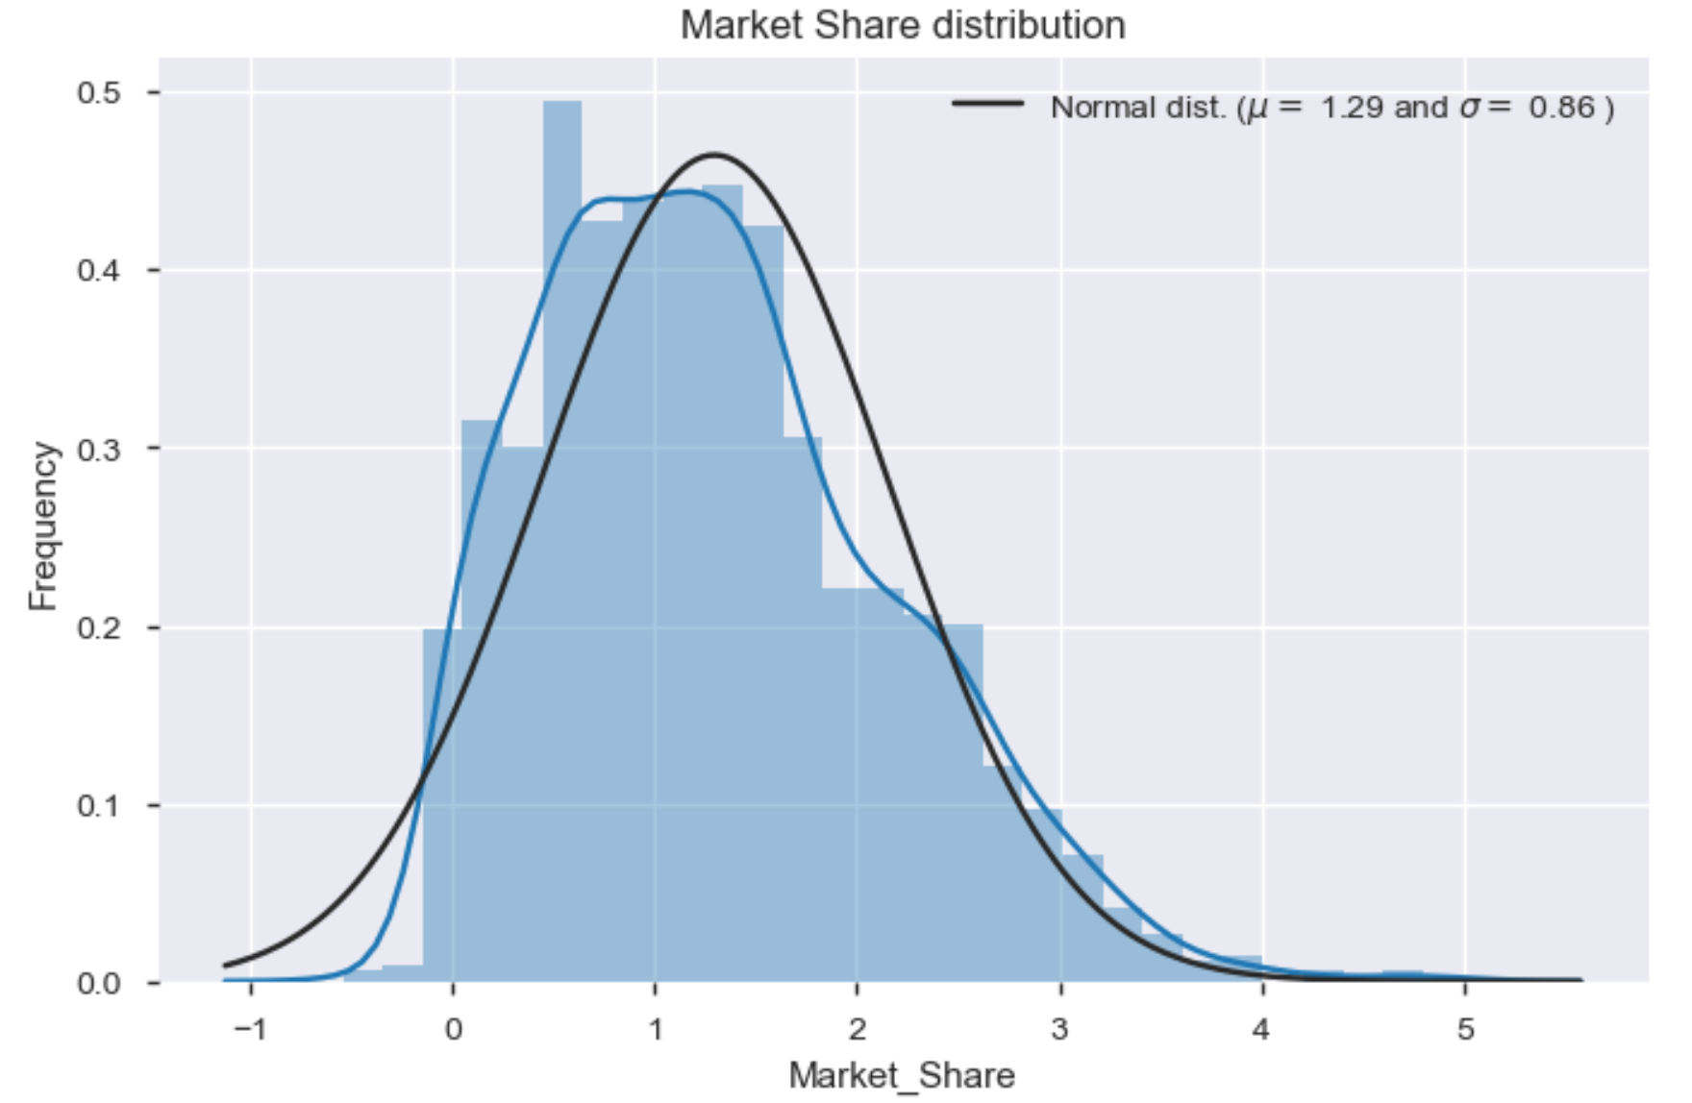
Data Prep 1
Labeled dataset: 1716 rows, 40 columns
Blind dataset: 29 rows, 39 columns
34 categorical, 5 numerical
Target variable
Class: 329 successful, 1387 unsuccessful
Prediction set also has multiple launch years
Meaning, it also contains observations from previous years
It is not like predicting the future, which would need a time series of some sort

Slide 6
Dataprep 2
Data type conversions
List of removals
BRMID' # Looks like an ID
,'NPLLAUNCHDATE' # This one can be removed because two derived features are based on it
,'NPLLAUNCHYEAR' # The derived feature is more useful than this
,'BLDIMAGE' # as plotted above, it's almost entirely image2
,'LEN' # LENCATEGORY is the binarized version, we don't need both
Check cardinality
'BRANDONMARKET', 'MARKETEDBRAND‘, ISREPLACEMENT', 'LATESTPERIODINDEX
Variable populations
['RTYPE', 'ITEMSHAPE', 'SPECIALFLAVOR', 'TIPCOLOR']
Summarize variable removals and drop

Slide 7
Dataprep 3
One hot encoding
['REGION', 'MARKET', 'BRANDDIFFERENTIATOR', 'BRANDFAMILY', 'BRANDSUBFAMILY', 'BRANDSUBFAMILYGROUP', 'BRANDSUBFAMILYGROUPING', 'BRANDSUBFAMILYLINE', 'CHARINDICATOR', 'INDICATOR', 'INTERNATIONALINDICATOR', 'ISSTRATEGIC', 'ITEMSCODE', 'LENCATEGORY', 'PRICECLASS', 'LOCALCLASS', 'MINDICATOR', 'PCKT', 'PRICECLASSON', 'TCLASS', 'THICATEGORY', 'TRACKINGSTATUS']
Detect correlated features
None in original, many in the one hot encoding
'BRANDSUBFAMILY , 'BRANDSUBFAMILYGROUPING
Train test Split
80% train , 20% test
Stratified on target class variable (20% successful)
Balancing (Undersampling)
263 successful (50%) / 263 unsuccessful (50%)
Final datasets
Test set size
66 successful / 278 unsuccesful
Algorithm | Estimator | Undersampling | One Hot Encoding | Samples | Features
CatBoost | Regressor | N | N | 1372 | 28
CatBoost | Classifier | Y | N | 526 | 28
XGBoost | Regressor | N | Y | 1372 | 265
XGBoost | Classifier | Y | Y | 526 | 265

Slide 8
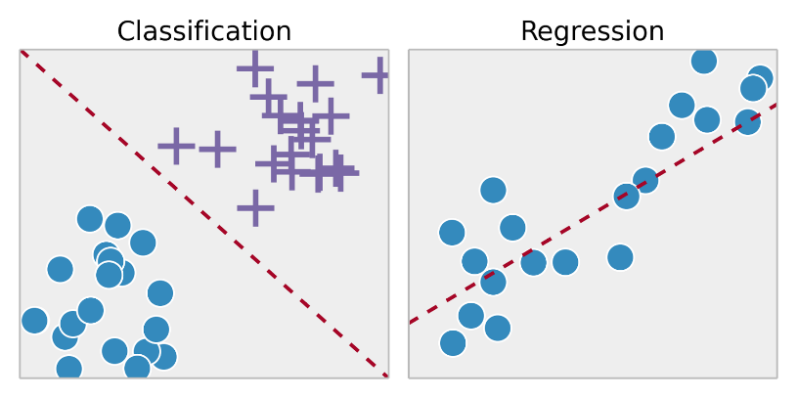
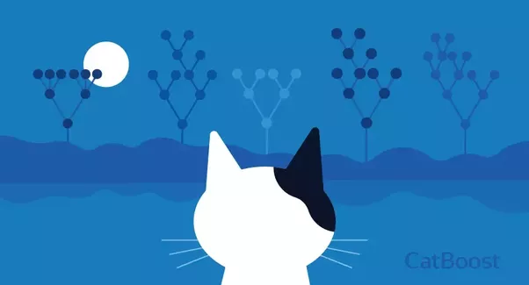

Modeling 1
Modeling approach with class & reg
Cat (2017 open sourced) vs XGB (created 2014, success in 2016)
Comparison https://towardsdatascience.com/catboost-vs-light-gbm-vs-xgboost-5f93620723db
Both GPU accelerated
Important features
CatBoost | XGBoost
Market | Retail Pack Price
Indicator | Ncon
Price Class | Launch Year
Packet | Trconte

Slide 9
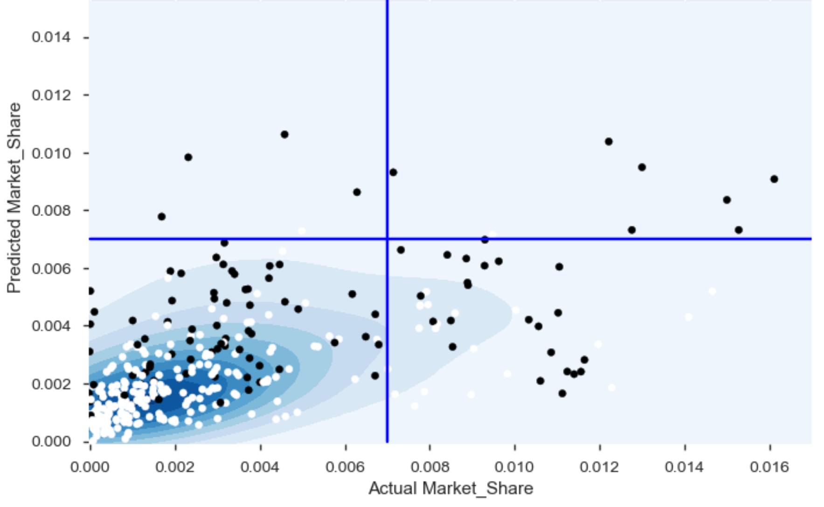
Modeling 2
Model | Accuracy | F1 | AUC
CatBoost | 71% | 0.46 | 0.68
XGBoost | 63% | 0.38 | 0.62
Model | MSE | R2
CatBoost | 0.0026 | 0.15
XGBoost | 0.0029 | 0.08
Model results comparison
Explain model confidence
Classification test results
Regression test results
Best model error plot
Explain quadrants like confusion matrix
Explain density around smaller numbers is good
Confidence interval can be tought as
Reg +- 0,26 error margin
Class each prediction has its probability score

Slide 10
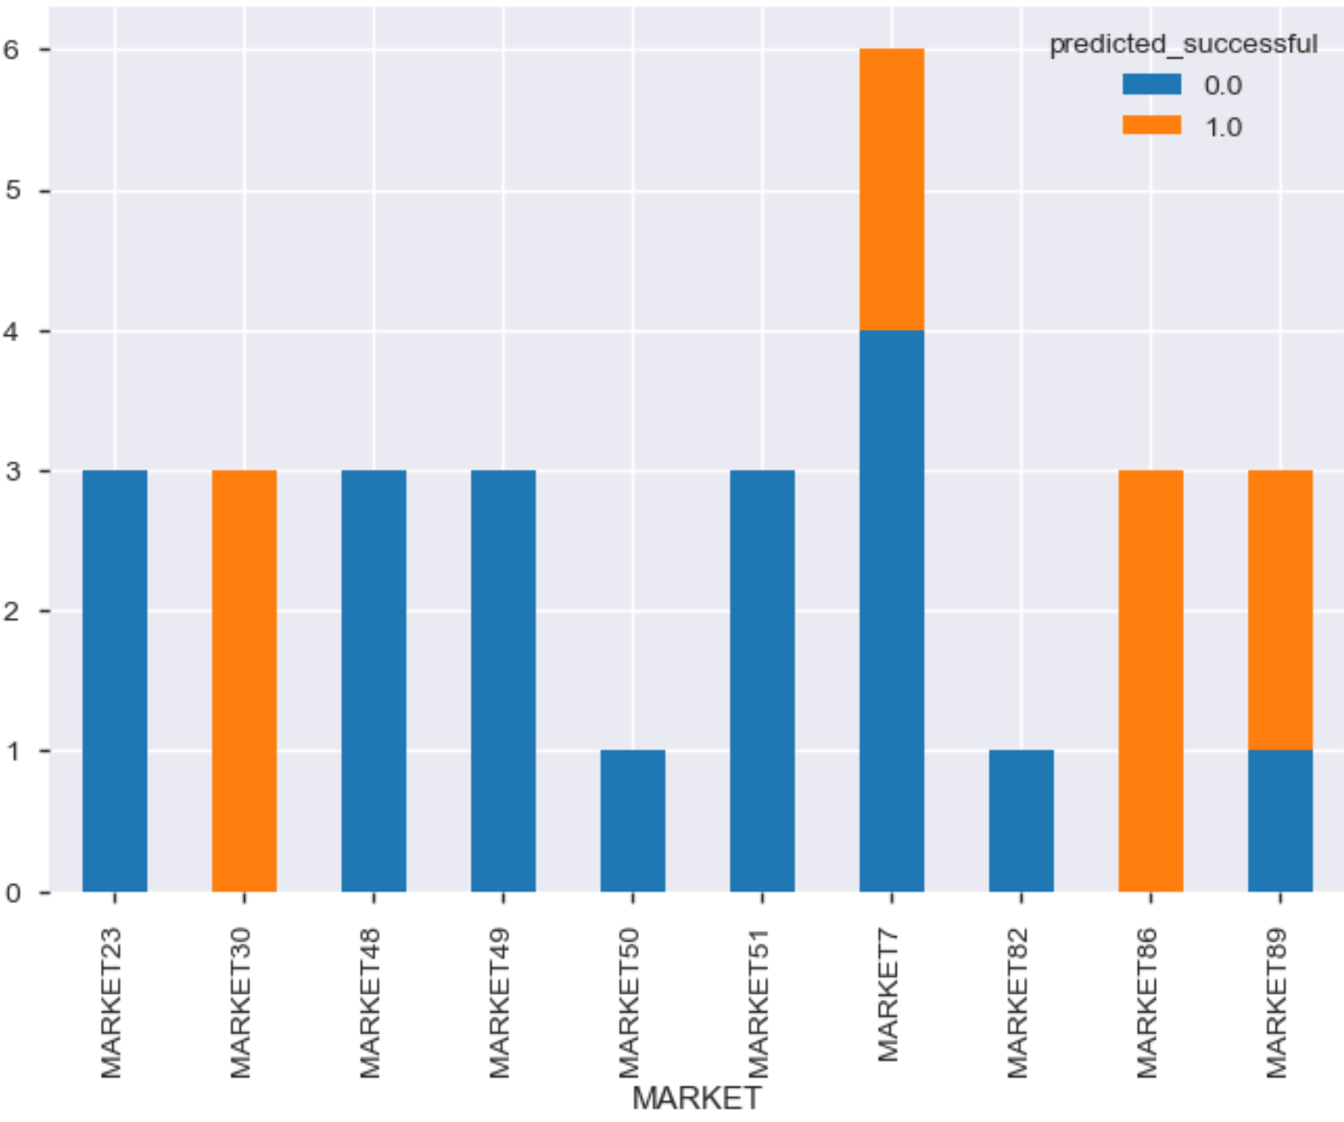
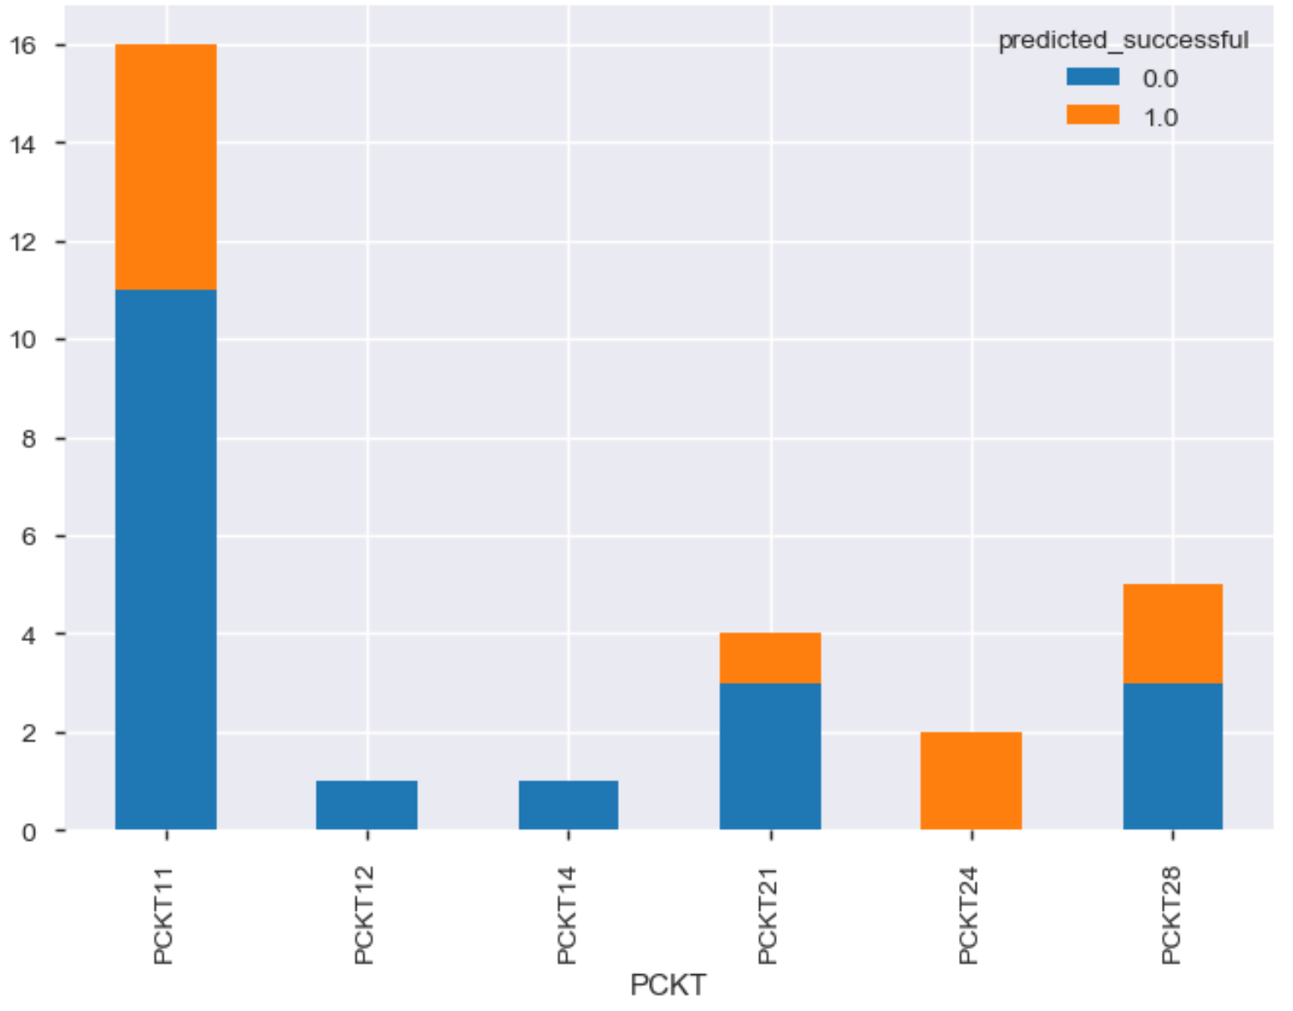
Predictions 1
Summary
29 Products
Classification tells 19 will be successful (too optimistic)
Regression tells only 3 will be successful (too pessimistic)
Trends
Success seems tied with the market
Packet also shows an interesting pattern

Slide 11
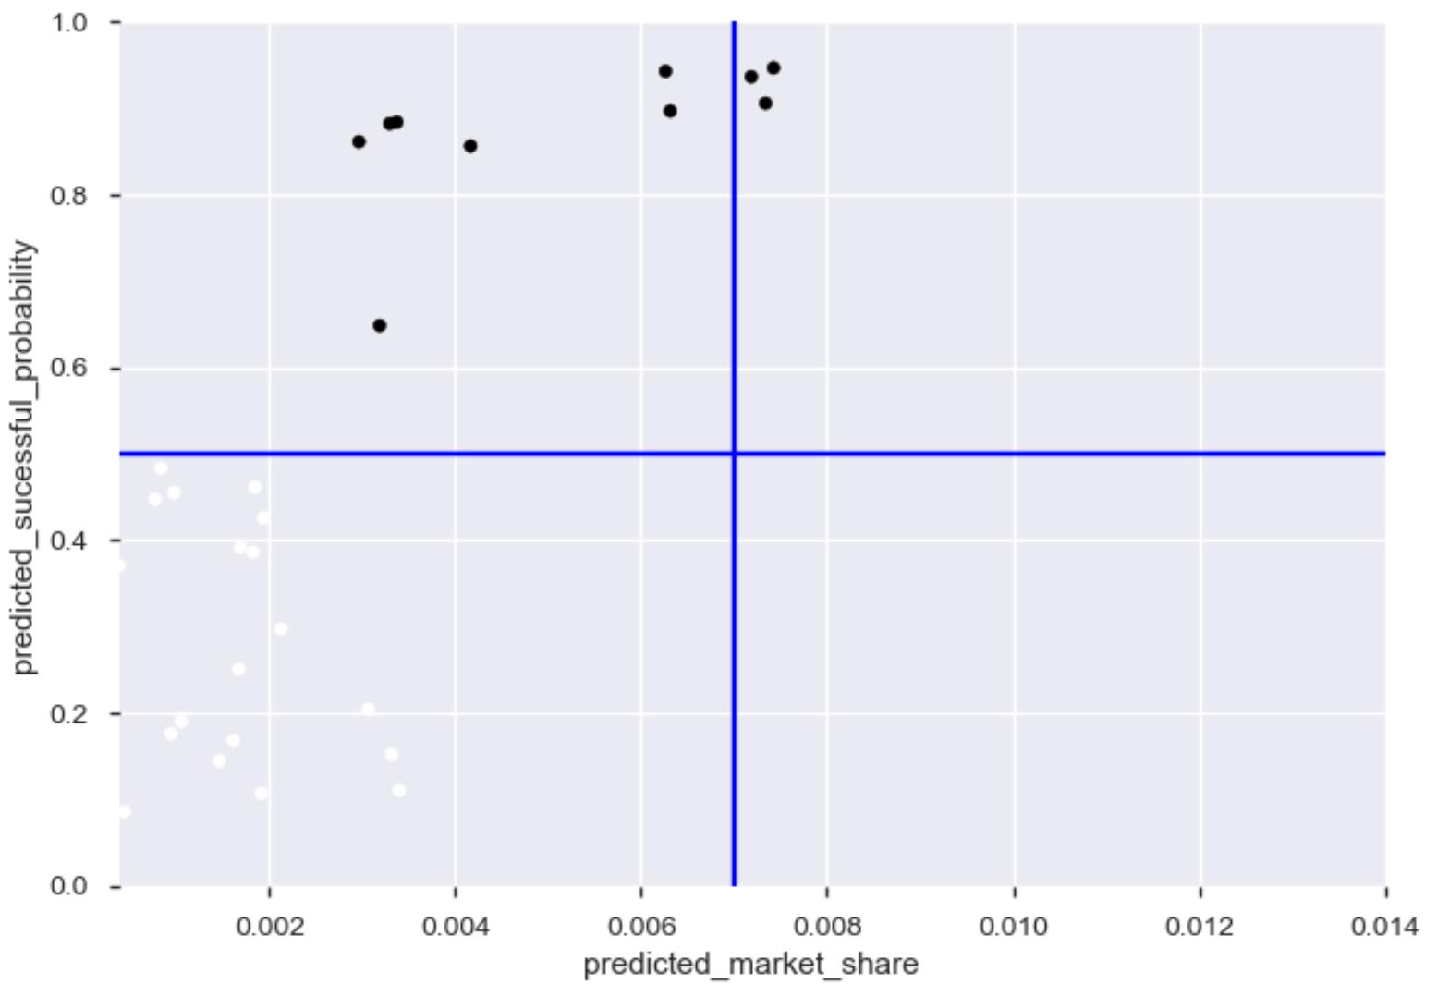
Predictions 2
Models agrees on 3 of them
Explain by quadrant

Slide 12
NEXT STEPS
Data preprocessing
Additional data sources
Creation and use of validation datasets (didn’t do because of amount of data)
Additional feature selection approaches (permutation based)
More feature transformations (normalization)
Missing data imputation
Additional balancing techniques (smote, rose…)
Additional data cleaning
Play with the threshold so it can generate more balanced dataset
Modeling
Apply more regularization to prevent overfitting
Use validation sets
Cost sensitive learning (use sample weight in the loss function)
Additional algorithms
Ensembling
Deeper model interpretation (Lime, shapley, partial dependencies)

Slide 13
Thank you

